Slide 1

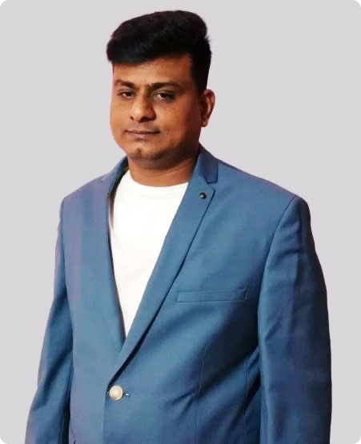
Devendrappa
Certified Scrum Master (CSM) | Agile Practitioner
"Helping teams deliver high-quality software through Agile & Scrum practices"

Slide 2
About Me
I am a Certified Scrum Master (CSM) with 10 years of experience.
Facilitation
Coaching
Remove Impediments
Facilitating Agile ceremonies. Daily stand-ups, sprint planning, reviews, and retrospectives.
Coaching teams to embrace Agile values. Improve team collaboration and communication.
Removing impediments to ensure smooth, high-performing Scrum teams.
My goal is to help businesses maximize productivity and deliver high-quality software. I also foster continuous improvement.

Slide 3
Skills and Competencies
Facilitation
Coaching
Conflict Resolution
Communication
Certifications
Sprint Planning
Mentoring team members
Identifying conflicts
Clear and effective
Certified ScrumMaster (CSM)
Daily Scrum
Stakeholders
Resolving conflicts
Stakeholders
Sprint Review
Leadership
Generative AI Overview for Project Managers,
Workshops
Google Project Management,
Agile Methodologies
Tools
Metrics
Scrum
Jira
Burndown
Kanban
Confluence
Velocity
XP
Trello
Customer Satisfaction
LeSS
SAFe
DD

Slide 4
Agile Project Management Expertise
Highlights include expertise in Agile methodologies (Scrum, Kanban, XP, LeSS, SAFe), facilitation & coaching, conflict resolution, and clear communication to ensure project success and team harmony.
Agile Methodologies
Facilitation & Coaching
Expert in Scrum, Kanban, XP, LeSS, and SAFe frameworks. Flexible to adapt to the best approach.
Skilled in sprint planning, daily scrums, and retrospectives. Mentoring teams and stakeholders.
Conflict Resolution
Communication
Resolving team and stakeholder conflicts. Ensuring alignment for project success and team harmony.
Clear and effective communication is crucial for all stakeholders. I ensure everyone is informed.

Slide 5
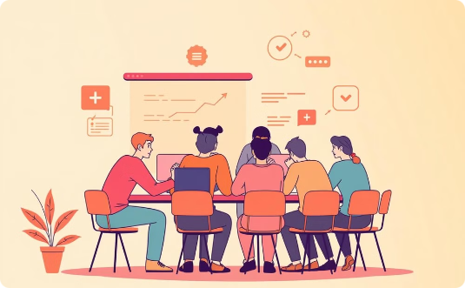

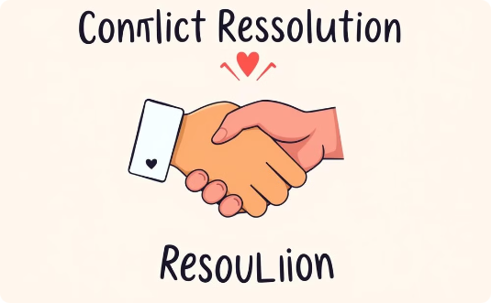
Skills and Competencies
Agile Methodologies
Facilitation & Coaching
Conflict Resolution
Proficient in Scrum, Kanban, XP, LeSS, and SAFe. Adaptable to various frameworks.
Expert in sprint planning, daily scrums, reviews. Mentoring team and stakeholders.
Resolving conflicts within the team. Ensuring stakeholder alignment for project success.

Slide 6

Work Experience / Case Studies Case Study
Narayana Health – Zendesk Sell & Support Implementation
Client Overview:
Industry: Healthcare
Agents: 250
Systems Integrated: HMS, EMR, Telephony
Challenges Faced:
Sales & Lead Management Issues – Manual lead handling, poor pipeline visibility
Inefficient Customer Support – No automated ticket routing, slow response times
Data Migration & Integration Gaps – Needed seamless transition & system connectivity
Lack of Self-Service & Reporting – High agent workload, no real-time insights
Solutions Implemented:
Zendesk Sell: Automated lead assignments, custom sales pipeline, omnichannel lead flow
Zendesk Support: Ticket automation, SLA tracking, omnichannel customer service
Self-Service Portal & Chatbot: FAQ, Knowledge Base, automated query resolution
System Integration & Data Migration: HMS, EMR, Appointment System, Telephony
Reports & Dashboards: 25+ custom reports for SLA, CSAT, backlog, & conversions
Training & Change Management: 3-day structured training for 250+ agents
Results & Business Impact:
30% increase in lead conversions through structured sales workflows
40% faster customer response times via automated ticket assignment
25% improvement in ticket resolution speed, enhancing CSAT
35% better SLA compliance reducing backlog & service delays
40% self-service adoption reducing agent workload
Successful data migration with seamless system integrations
Project Team:
Project Manager
Solution Architect
Business Analyst
Zendesk Consultants
Integration Developer
Data Migration Specialist
Training Lead

Slide 7
Case Study: Glassco - Zendesk Sell CRM Implementation
Results & Impact
📈 Better Sales Tracking – Real-time monitoring of sales reps’ visits & activities. 📊 Higher Lead Conversion – Improved customer follow-ups & sales efficiency. 🚗 Automated Travel Expense Management – Easy reimbursement process for sales reps. 🔗 Improved Integrations – Seamless flow of data across CRM, SAP, and LinkedIn. 📞 Faster Response Time – Quick communication through multiple channels.
Technology Used
🛠 Middleware Software:
Zendesk Sell (CRM)
Google Maps API (Travel tracking)
🛠 Integration Services:
SAP & LinkedIn (Lead & sales data sync)
Facebook, WhatsApp, and Zapier (Multi-channel sales communication)
Knowlarity (Call Recording integration)
🛠 Project Management & Reporting:
Agile methodology
Custom dashboards for sales performance tracking
Data Migration
🔄 Minimal data migration – Imported contacts & leads from SAP to Zendesk Sell.
Project Overview
Glassco, a leading lab glassware manufacturer, needed a CRM solution to manage their sales team,
track customer interactions, and automate sales processes. The goal was to improve sales tracking,
travel expense management, and multi-channel communication.
Client Details
Client Name: Glassco Laboratory Equipment Pvt. Ltd.
Industry: Laboratory Equipment Manufacturing & Export
Company Size: 1000+ employees, exporting to 80+ countries
Sales Team: 25 sales agents across India
Challenges Faced
❌ Manual Sales Tracking – No system to track sales visits or reps' travel history. ❌ Limited Lead Management – No centralized platform for managing customer interactions. ❌ Expense Calculation Issues – Needed an automated mileage tracker for travel reimbursements. ❌ Lack of Integrations – No connection between SAP, LinkedIn, and CRM for smooth data flow. ❌ Multi-Channel Support Missing – Needed integration with WhatsApp, Facebook, and LinkedIn.
Solution Implemented
✅ Zendesk Sell CRM – Configured for 25 sales agents with a custom sales pipeline. ✅ Google Maps Auto Mileage Tracker – To track sales reps' travel history & calculate expenses. ✅ SAP & LinkedIn Integration – Seamless data sync for leads, contacts, and sales insights. ✅ Multi-Channel Communication – Integrated WhatsApp, Facebook, LinkedIn, Zapier, and Call Tracking. ✅ Automated Reporting & Dashboards – For sales performance, lead conversion, and expenses. ✅ Sales Rep Activity Monitoring – Geo-tagging for visits & automated report generation. ✅ Training & Support – Ensured smooth system adoption and efficient use.

Slide 8
Case Study: Everise - Zendesk Suite + ITSM Implementation
Project Overview
Everise partnered with Estuate to implement Zendesk Suite + ITSM Platform to enhance customer support,
IT service management, and automation. The goal was to improve ticket resolution, operational efficiency,
and customer experience while integrating with enterprise applications.
Client Details
Client Name: Everise
Industry: Customer Experience & Digital Transformation
Company Size: Global operations with 460,000+ employees
Challenges Faced
❌ Difficult Ticket Logging – Users struggled to log tickets via chat, mobile, or other channels. ❌ Inefficient ITSM Operations – Current system lacked scalability & automation. ❌ Limited Reporting & Insights – No visibility into ticket resolution, SLAs, and performance. ❌ Lack of Integration – No unified system for Change, Incident, and Asset Management.
Solution Implemented
✅ Zendesk Suite Implementation – Support, Guide, Explore (Omnichannel Helpdesk). ✅ ITSM Integration – Change Management (MyndBend), Incident Management (OpsGenie). ✅ Multi-Channel Support – Portal, Voice, Chat, Email, SMS, Web Forms, Social Media
(Facebook, Twitter, WhatsApp, Telegram, Instagram). ✅ HRMS & Active Directory Integration – Seamless access control & identity management. ✅ Automated SLA Tracking – Workflow-based ticketing & escalation management. ✅ Analytics & Dashboard – Out-of-the-box reporting for business intelligence. ✅ Multi-Language Support – English & Japanese for global teams.
Results & Impact
📈 Improved Customer Satisfaction – 55% → 92% due to faster ticket resolution. 📊 Boosted Agent Productivity – Handled 2x to 10x more tickets efficiently. ⏳ Reduced First Response Time – 37 hours → 7 hours in under 7 months. 📉 Cost Reduction – 20% lower support costs & 66% fewer billable helpdesk hours. ⚡ Enhanced ITSM Performance – 19% increase in ticket resolution efficiency.
Technology Used
🛠 Middleware Software:
MyndBend (Change Management)
OpsGenie (Incident Management)
Device42 (Asset Management & IT Inventory)
🛠 Integration Services:
QualityKiosk HRMS & Active Directory (Identity Management)
Social Media Platforms (Facebook, WhatsApp, Twitter, Telegram, Instagram)
Oomnitza Integration (IT Asset Tracking)
🛠 Project Management & Reporting:
Agile methodology
Custom dashboards & KPIs for ITSM efficiency tracking
Data Migration
🔄 No Major Data Migration – New system setup without legacy data transfer.

Slide 9
Project Case Study: QualityKiosk - Zendesk Suite + ITSM Implementation
1. Project Overview:
QualityKiosk partnered with Estuate to implement Zendesk Suite with ITSM (IT Service Management) capabilities to enhance their incident, change, and problem management workflows.
The project aimed to automate service requests, integrate ITSM with enterprise applications, and provide actionable analytics for improved decision-making.
2. Client Name: QualityKiosk
3. Client Overview: QualityKiosk is a leading provider of Quality Assurance and Digital Testing solutions. The company specializes in performance engineering, automation, and monitoring services for enterprises across various industries.
4. Client Industry: IT Services and Software
5. Client Challenges:
Inefficient ITSM Workflows: Manual handling of incident, change, and problem management caused delays and inefficiencies.
Lack of Unified System: No single platform to manage IT services, leading to data silos.
Limited Self-Service Options: End users had no self-service capabilities for common service requests.
Lack of Integration: Existing HRMS and Active Directory systems were not integrated with ITSM.
Inadequate Analytics: No centralized reporting for service performance and resolution tracking.
6. Solution Implemented:
Zendesk Suite Configuration (Support, Guide, Answer Bot, Explore).
Automated ITSM workflows for incident, change, and problem management.
SLA-based ticket tracking and escalation mechanisms.
Integration with QualityKiosk HRMS & Active Directory.
Multi-channel support (Email, Chat, SMS, Web Forms, Portal).
Dashboards & Reports for analytics and performance tracking.
7. Results & Impact:
Customer satisfaction increased from 55% to 92%.
Agent productivity improved by 2x to 10x.
First response time reduced from 37 hours to 7 hours.
19% increase in ticket resolution efficiency.
20% reduction in IT support costs.
8. Technology Used:
Middleware Software Used:
MyndBend (Change Management)
OpsGenie (Incident Management)
Zendesk Sunshine (Custom extensions & integrations)
Tools & Techniques Used to Manage the Project:
Project Management: Agile methodology, Jira for tracking
ITSM Frameworks: Incident, Problem, and Change Management
Analytics & Reporting: Custom dashboards for real-time performance tracking
Integration Services:
Integrated Zendesk with QualityKiosk HRMS & Active Directory
Third-party integrations:
Jira (Issue tracking & ticketing)
Salesforce (SFDC) (CRM integration)
SAP (ERP integration)
Google Maps API (Location-based services)
GitHub (Version control & collaboration)
Device42 (Asset management)
Payment Gateway Integration (Online transactions)

Slide 10
Case Study: The Art of Living - Salesforce Sales & Marketing Cloud Implementation
Project Overview
The Art of Living partnered with Kloudrac Inc. to implement Salesforce Sales & Marketing Cloud for improved customer engagement, marketing automation, and sales management. The goal was to streamline operations, enhance analytics, and optimize lead management.
Client Details
Client Name: The Art of Living
Industry: Non-Profit, Wellness & Education
Solution Focus: CRM & Marketing Automation
Challenges Faced
❌ Disconnected Sales & Marketing Processes – Lack of centralized data and automation. ❌ Inefficient Lead Management – Difficulty in tracking and nurturing leads. ❌ Limited Reporting & Insights – No real-time dashboards for performance tracking. ❌ Manual Data Handling – No integration with legacy systems for automation.
Solution Implemented
✅ Salesforce Sales & Marketing Cloud Setup – Centralized CRM for sales & marketing. ✅ Marketing Automation – Custom workflows for lead nurturing, email campaigns, and customer segmentation. ✅ Data Migration & Integration – Seamless migration of legacy data into Salesforce. ✅ Custom Dashboards & Reporting – Real-time insights into customer engagement & sales performance. ✅ Mobile CRM Access – Enabled on-the-go access for sales & marketing teams. ✅ User Training & Support – Ensured smooth adoption of the new system.
Results & Impact
📈 Improved Lead Conversion – Better tracking & engagement increased conversions. 📊 Automated Sales & Marketing – Reduced manual workload, improving efficiency. 📉 Enhanced Data Visibility – Real-time reporting for better decision-making. 📬 Personalized Customer Engagement – Targeted email campaigns increased response rates. 🔗 Seamless Integration – Smooth data flow between Salesforce, marketing tools, and existing systems.
Technology Used
🛠 Middleware & CRM Platform:
Salesforce Sales Cloud (Lead & customer relationship management)
Salesforce Marketing Cloud (Email automation & campaign management)
🛠 Integration Services:
Legacy System Integration (Data migration & sync)
Bolt-On Integrations (Custom API connections for third-party tools)
🛠 Project Management & Reporting:
Agile methodology
Custom dashboards for lead tracking & campaign performance
Data Migration
🔄 Migrated customer & sales data from legacy systems into Salesforce.

Slide 11
Skills and Competencies
Agile Methodologies
Facilitation
Proficient in Scrum, Kanban, XP, LeSS, and SAFe frameworks.
Skilled in sprint planning, daily scrums, and retrospectives.
Coaching
Communication
Mentoring team members, stakeholders, and leadership.
Ensuring clear communication with all stakeholders.

Slide 12


Contact Me
📌 Upwork Profile Link : https://www.upwork.com/freelancers/~01daef5603f19d2620
Let’s work together to enhance your Agile team performance!
Feel free to reach out to me using the button below to connect and discuss how I can help your team or organization achieve its Agile goals.

